Slide 1
ECE 3130 Digital Electronics and Design
Lab 4
Adders and 4:1 MUX
Fall 2016

Slide 2
Objectives
Build and simulate a full adder & a 4-bit adder
XOR
AND = NAND + Inverter
OR = NOR + Inverter
Build and simulate a 4-to-1 multiplexer
Three 2-to-1 MUX’s

Slide 3
What are adders?
Digital circuits that perform addition of numbers
Half adder
Adds two 1-bit binary numbers
Full adder
Adds three 1-bit binary numbers
4-bit adder
Adds two 4-bit binary numbers & one 1-bit carry in

Slide 4
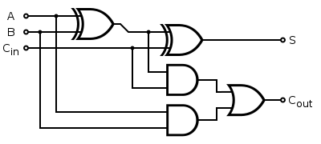
Full Adder
Truth Table
A | B | C | Sum | Carry
0 | 0 | 0 | 0 | 0
0 | 0 | 1 | 1 | 0
0 | 1 | 0 | 1 | 0
0 | 1 | 1 | 0 | 1
1 | 0 | 0 | 1 | 0
1 | 0 | 1 | 0 | 1
1 | 1 | 0 | 0 | 1
1 | 1 | 1 | 1 | 1
Implementation
OR Gate = NOR + Inverter

Slide 5
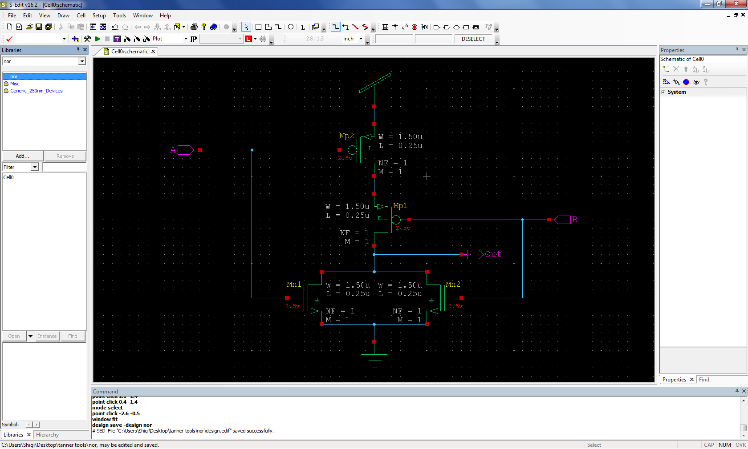
NOR Gate - schematic

Slide 6
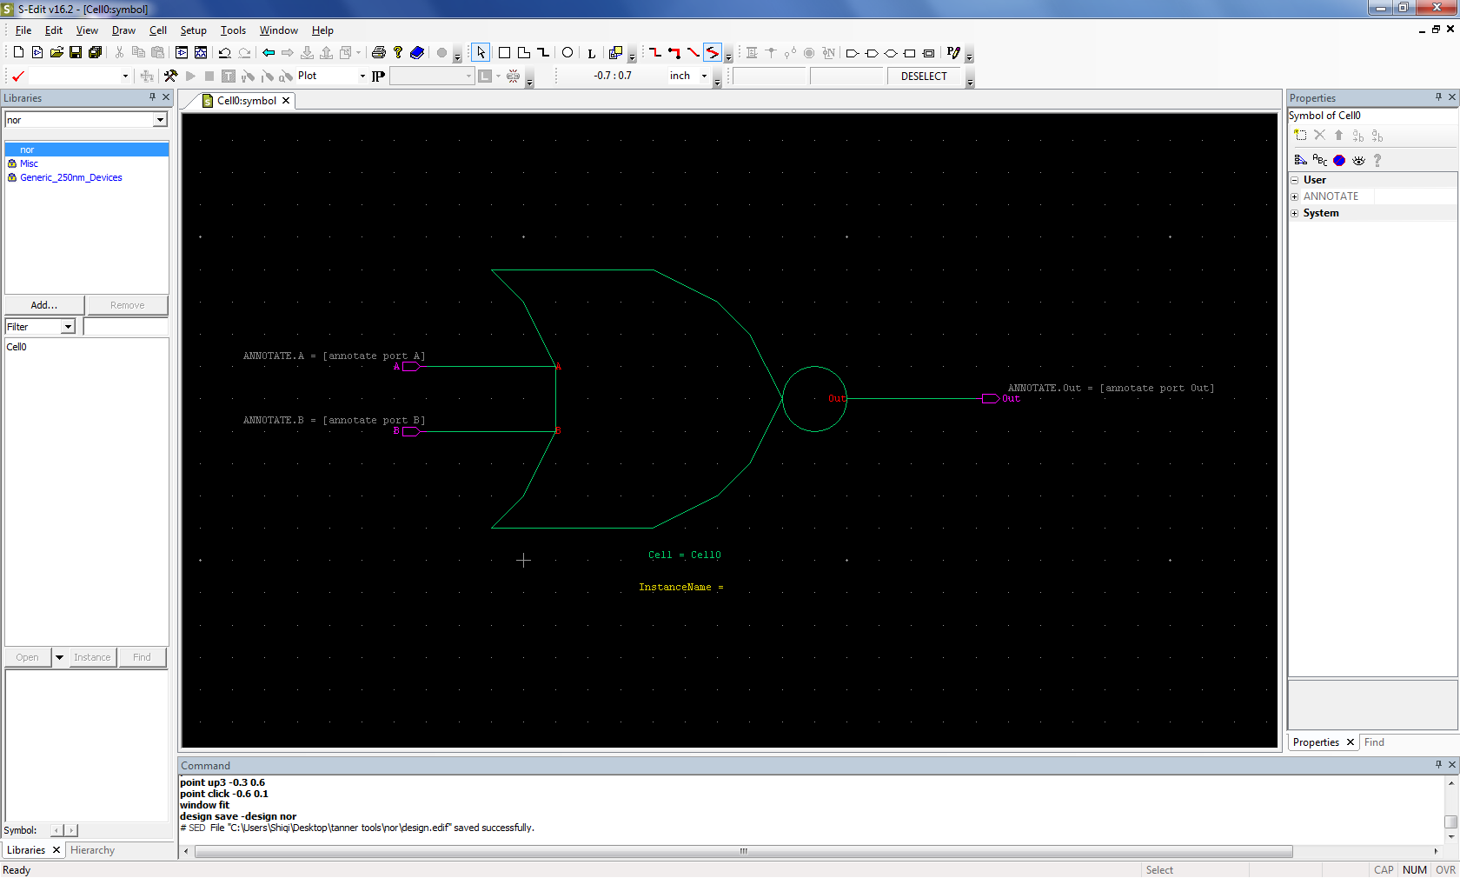
NOR Gate - symbol

Slide 7
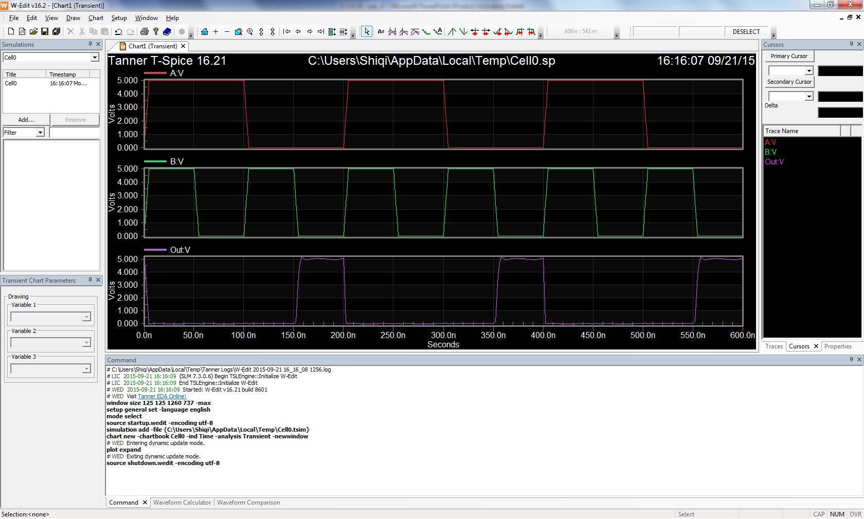
NOR Gate - waveforms

Slide 8
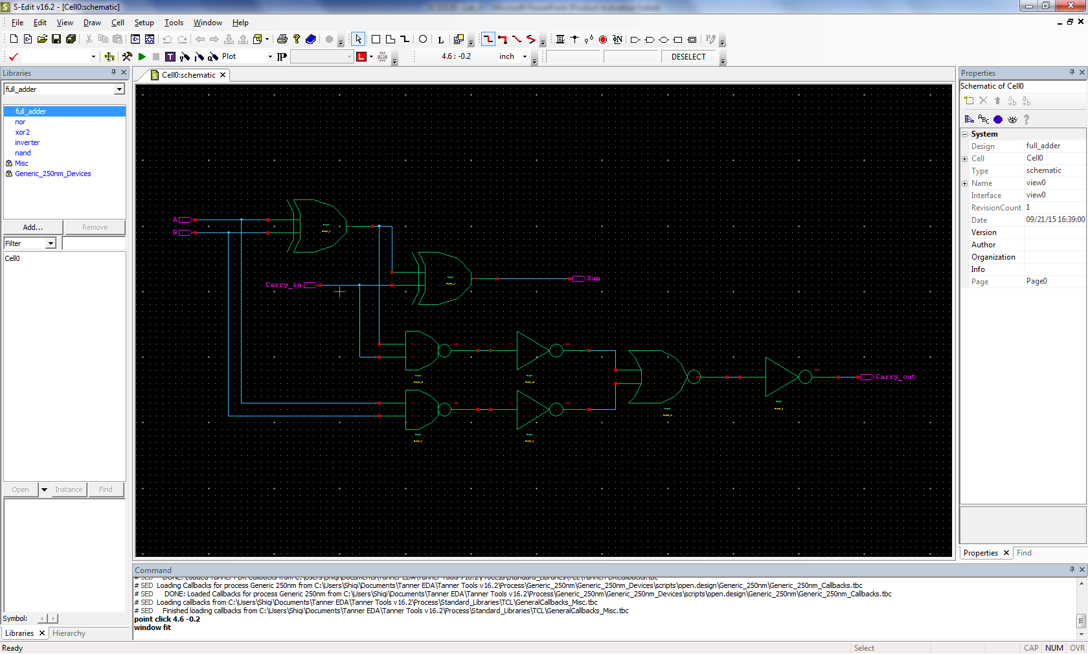
Full Adder - schematic

Slide 9
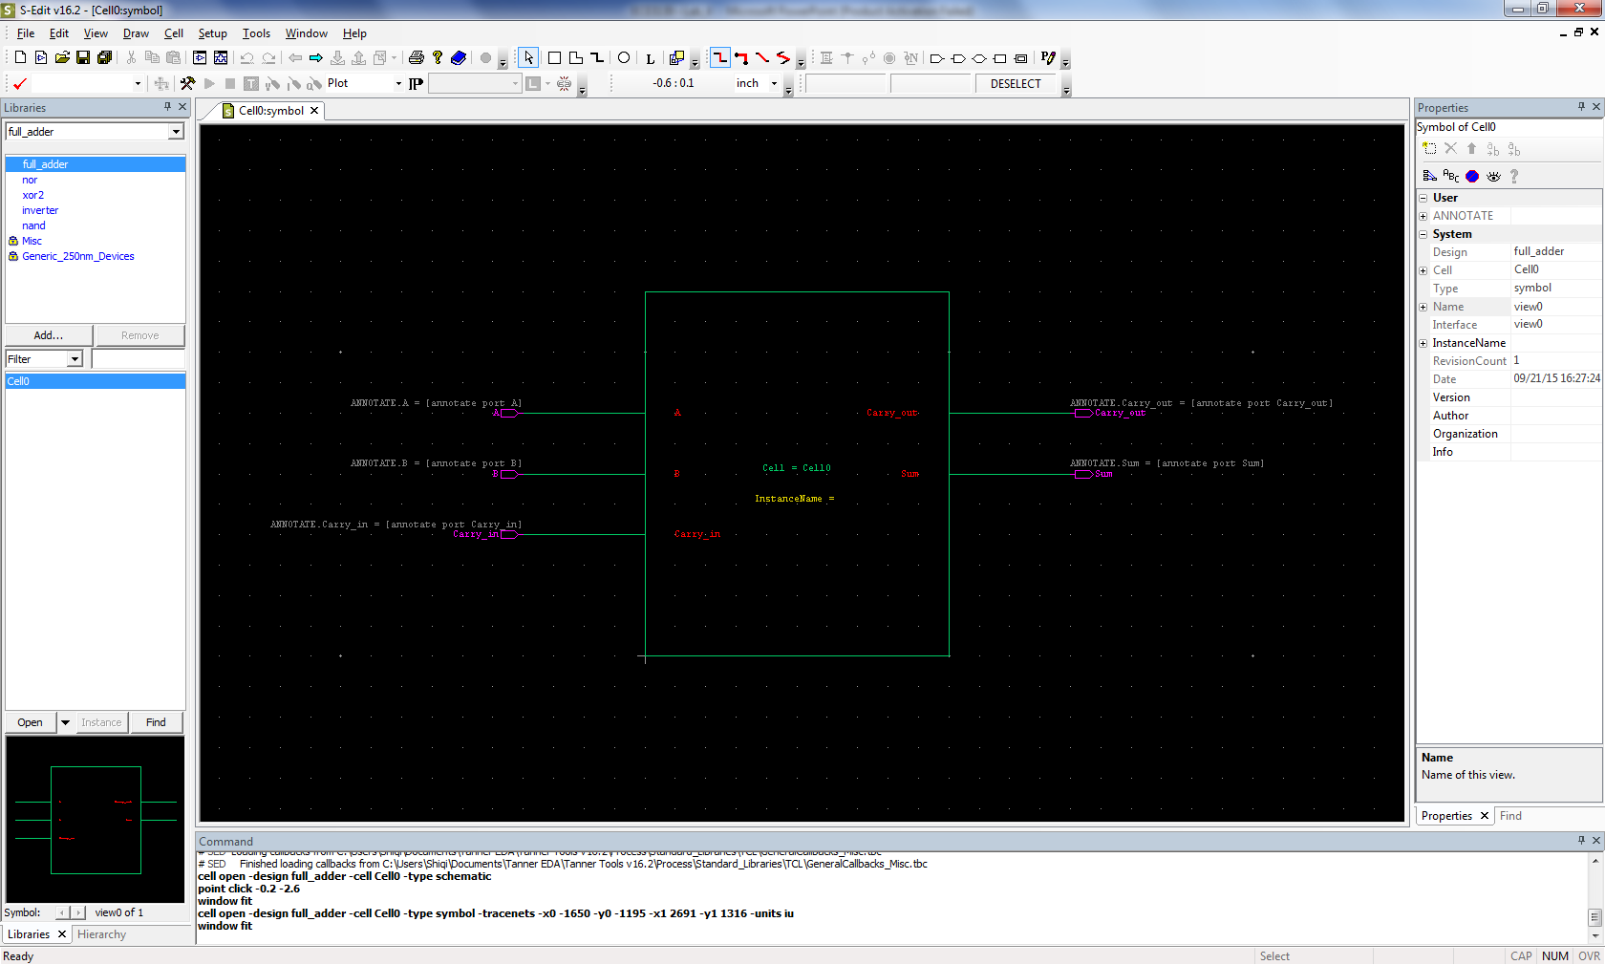
Full Adder – symbol

Slide 10
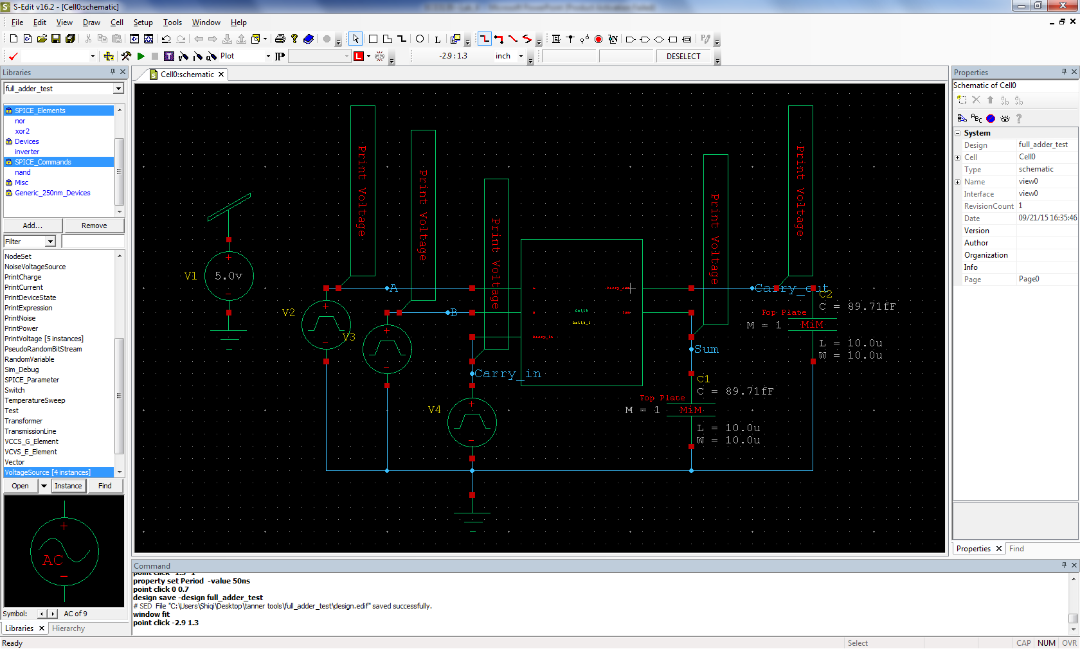
Full Adder – test circuit

Slide 11
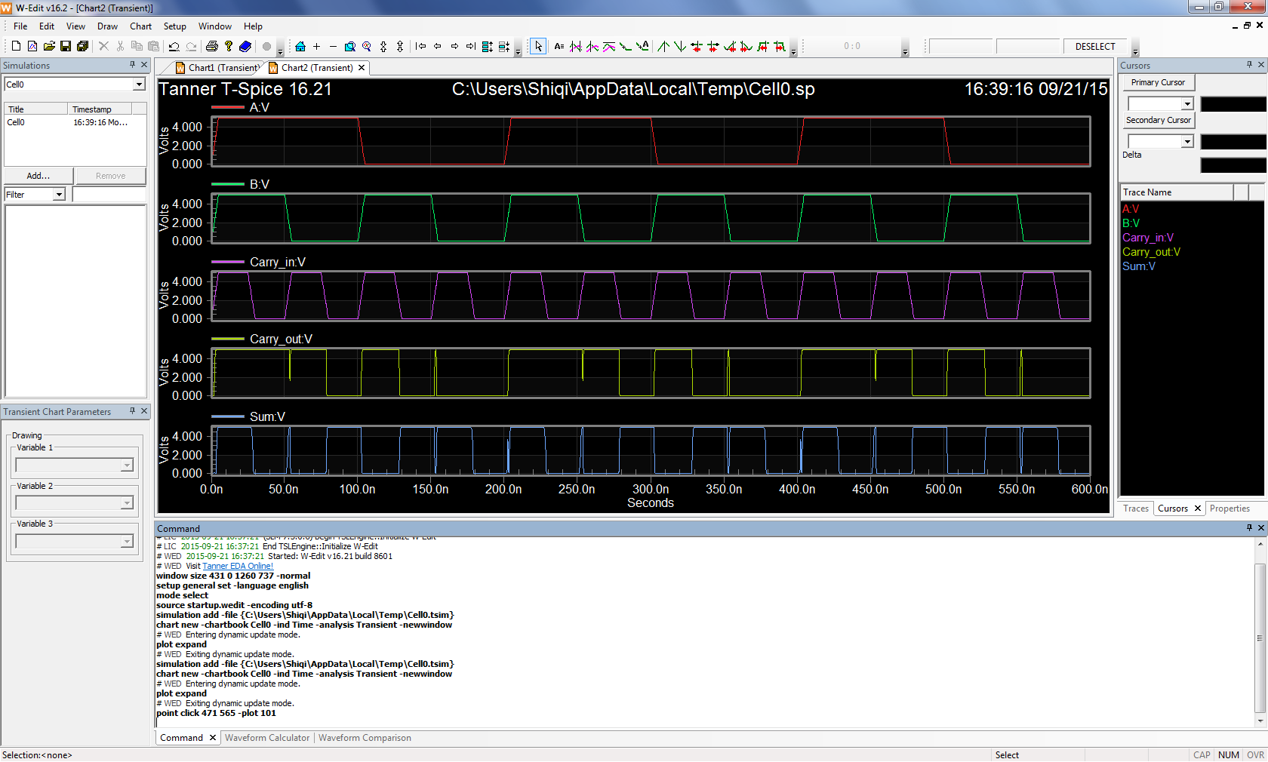
Full Adder – waveforms

Slide 12
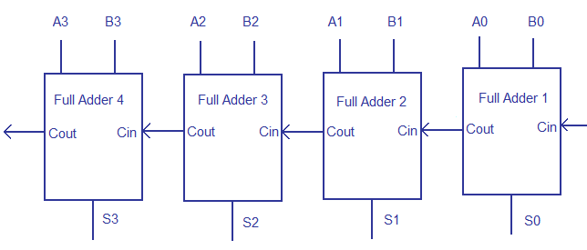
4-bit Adder

Slide 13
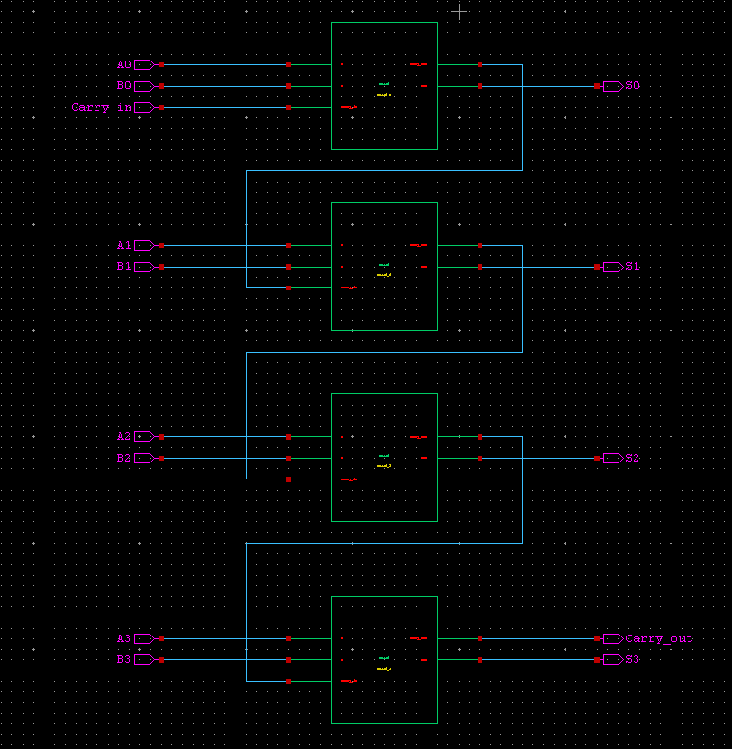
4-bit Adder - schematic

Slide 14
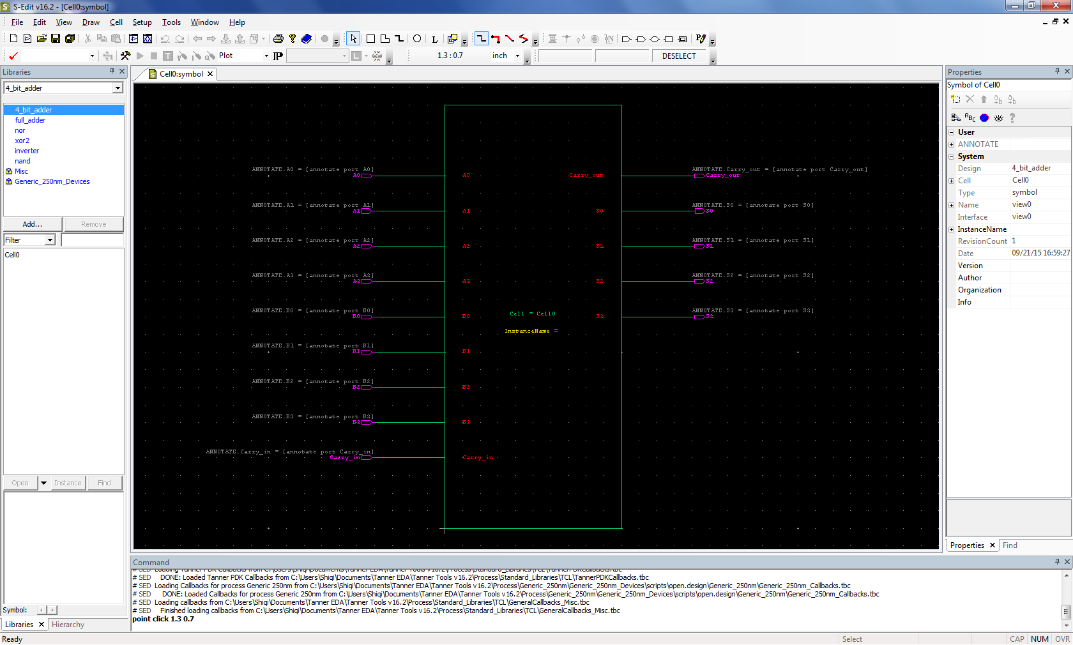
4-bit Adder - symbol

Slide 15
4-bit Adder – simulation
Test your 4-bit adder by setting up inputs:
A=1011, B=0111, Carry_in=1
Simulate it and check the results, which should be:
Sum=0011, Carry_out=1
P.S. A=1011 means A0=1, A1=1, A2=0, A3=1

Slide 16
What is a multiplexer (MUX)?
A device with multiple inputs and one output
Also known as a data selector or controlled switch

Slide 17
How does it work?
A MUX has n select lines, 2^{n} inputs and 1 output
The select line chooses which input to pass to the output
4-to-1 MUX has 2-bit select line and four 1-bit inputs, and one 1-bit output

Slide 18
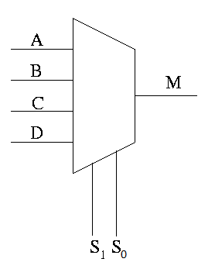
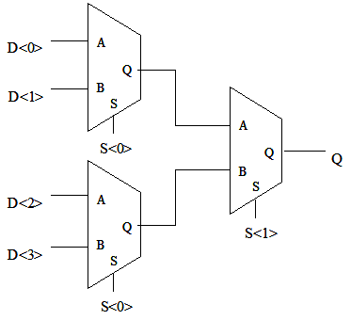
4-to-1 MUX
Truth table
S1 | S0 | Output (M)
0 | 0 | A
0 | 1 | B
1 | 0 | C
1 | 1 | D

Slide 19
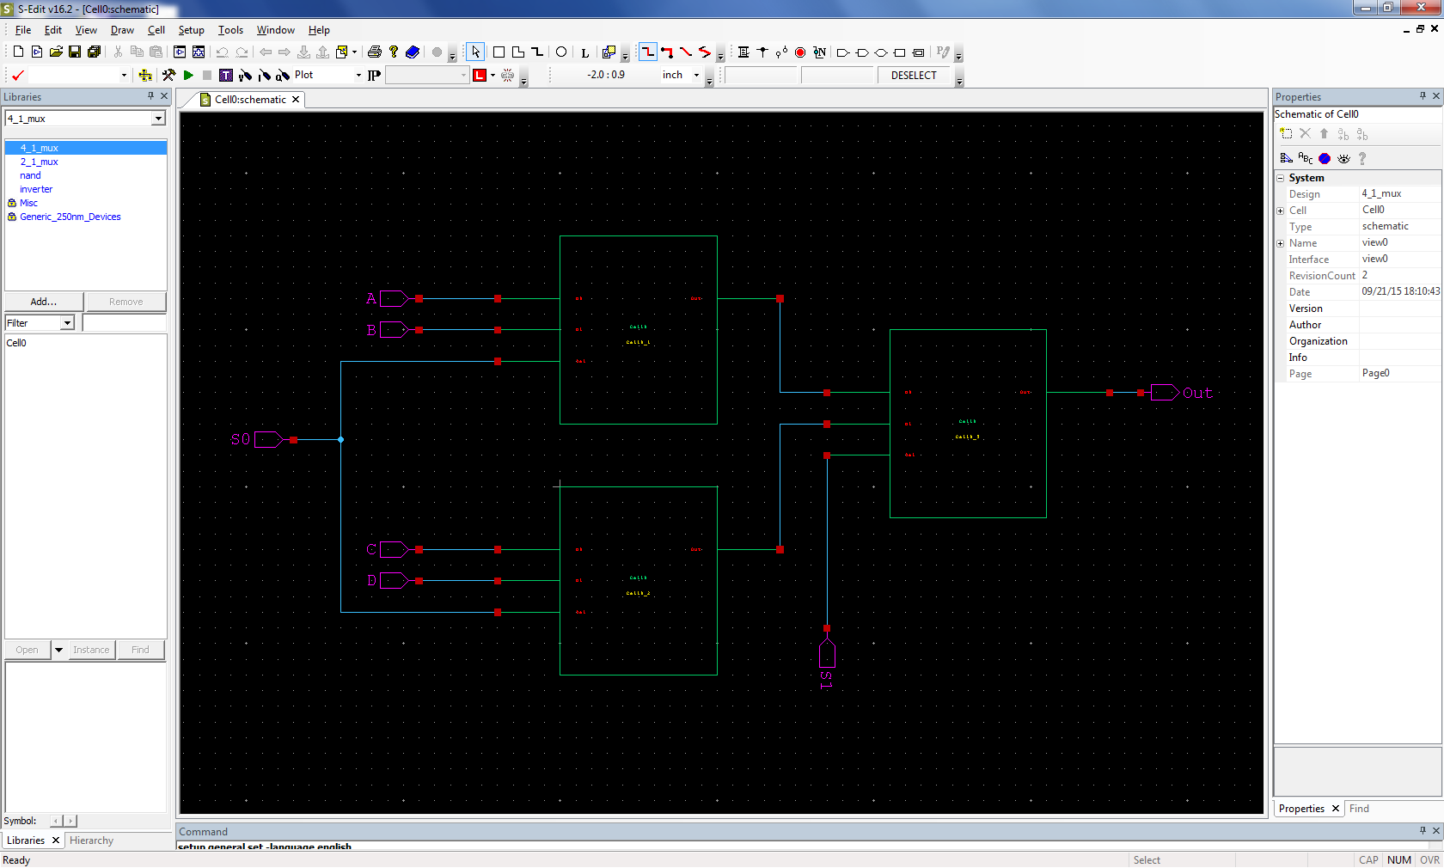
4-to-1 MUX - schematic

Slide 20
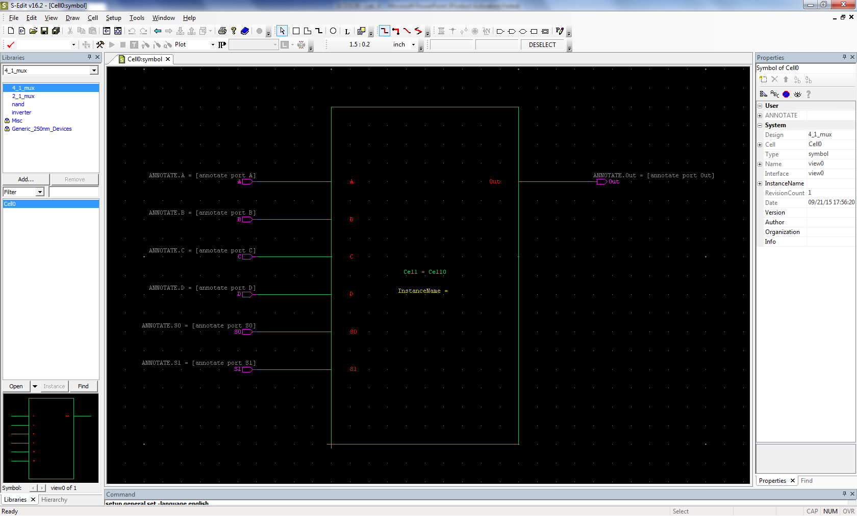
4-to-1 MUX – symbol

Slide 21
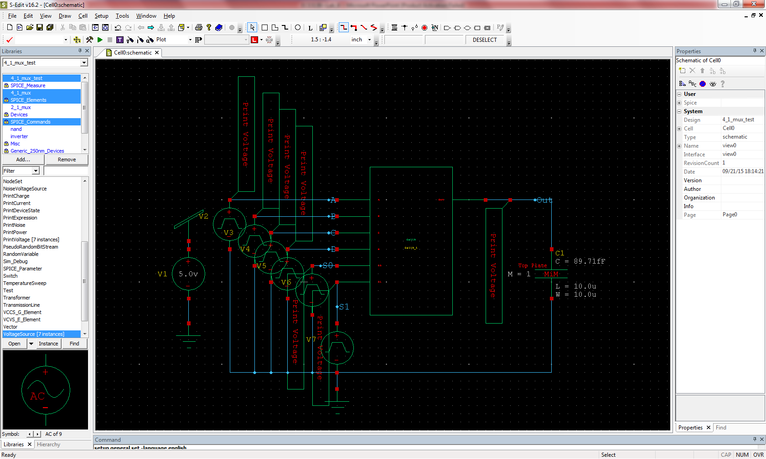
4-to-1 MUX – test circuit

Slide 22
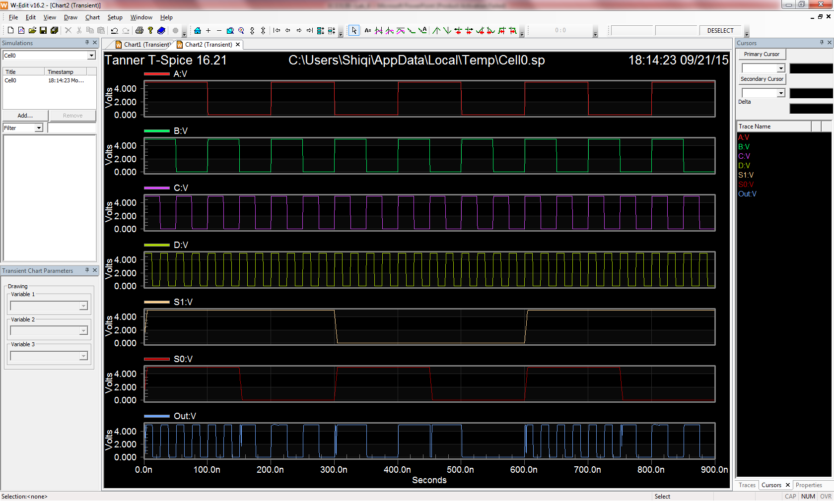
4-to-1 MUX - waveforms

Slide 23
Assignment
Build and simulate a Full Adder, a 4-bit Adder and a 4:1 MUX.
Attach all screenshots into one PDF file, including schematic, symbol, test circuit schematic, waveforms.

